Slide 1


Hii, Iam Siddhika
Welcome to Power BI Series
Part -8

Slide 2

Today Content
Hey! Join with me.
Continuation of
Power Query
MERGING QUERIES APPENDING QUERIES
POWER QUERY BEST PRACTICES
POWER QUERY INTERVIEW QUESTIONS POWER QUERY SUMMARY

Slide 3
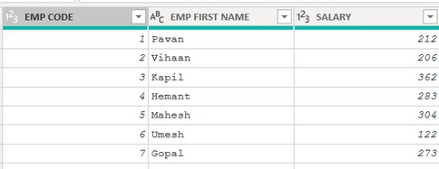
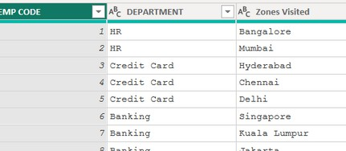
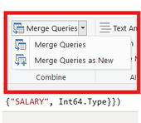

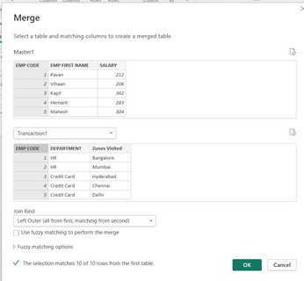
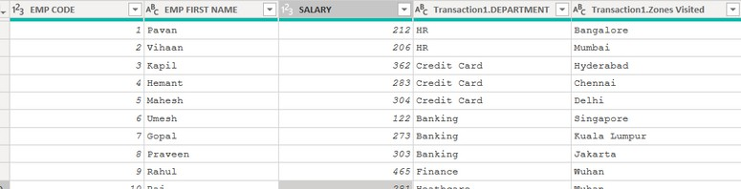

Merging queries allows you to join tables based on a common column.
Power Query
MERGING QUERIES
Check this?
Merge Queries: combines to the existed table.
Merge Queries as New: Joins both tables in a new table
we are merging above 2 tables with column EMP CODE
After merging we need to select the needed columns.
Varsha Chitikaneni

Slide 4
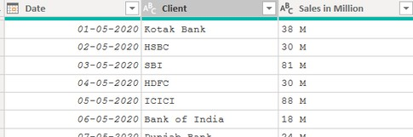

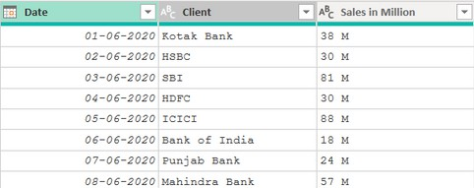
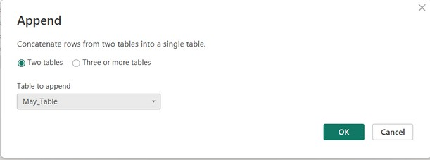
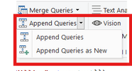
APPENDING QUERIES
Have you Appended?
Appending queries allows you to combine or stack tables sharing the exact same column structure and data types
Here we are appending these 2 tables. It is like SQL UNION .

Slide 5

POWER QUERY BEST PRACTICES
Organize Your Data:
Use clear and intuitive table/query names.
Establish an organized file/folder structure.
Disable Unnecessary Refresh:
Disable report refresh for static data sources.
No need to refresh data sources that don't change.
Load Only Necessary Data:
Remember these points?
Load only the data you need, especially with large tables. Avoid loading unnecessary data to improve report performance.
Optimize Data Loading:
Choose appropriate refresh schedules based on data volatility.
Optimize data loading settings to balance performance and freshness

Slide 6
POWER QUERY INTERVIEW QUESTIONS
What is Power Query, and what role does it play in Power BI?
How do you connect to different data sources using Power Query?
Can you explain the process of data transformation in Power Query?
What are some common data transformation operations you can perform in Power Query?
How do you handle missing or duplicate data in Power Query?
Explain the difference between merging and appending queries in Power Query.
What are conditional columns, and how do you create them in Power Query?
Describe the purpose of index columns in Power Query.
How can you create a calendar table using Power Query?
What are some best practices for optimizing data loading and transformation in Power Query?
Check these Questions?

Slide 7

POWER QUERY SUMMARY
Connecting to Data: Learn how to connect to various data sources like
databases, files, and online services.
Data Transformation: Understand the process of transforming data using Power Query, including cleaning, shaping, and restructuring.
Column Operations: Explore different column operations such as adding, removing, renaming, and splitting columns.
Advanced Transformations: Dive into advanced transformations like conditional columns, index columns, and date/time manipulations.
Combining Queries: Discover how to merge and append queries to combine data from multiple sources.
Data Profiling: Utilize data profiling techniques to analyze data quality, distribution, and patterns.
Pivoting and Unpivoting: Master the art of pivoting and unpivoting data to reshape it for analysis.
Best Practices: Learn best practices for efficient data loading, transformation, and query management.
What you learned from Power Query?

Slide 8

Thank you for joining me on this journey through Power Query!
Remember, With these tools and techniques, you're now equipped to efficiently shape and transform your data for insightful analysis.
Stay tuned for more insights and tips on Power BI in our next Series.
Follow
Siddhika Shah

